Slide 1
Chapter 6 Lesson 4
Civil Rights and Culture.
Problems with water resources.

Slide 2
Key Ideas
New Mexico’s Black, Hispanic, and Native American citizens fought for their civil rights.
Hispanic New Mexicans continued their efforts to reclaim lost land grants.
Minorities worked to preserve their cultures.
New Industries and population growth continue to strain New Mexico’s water resources.

Slide 3
Key Terms
Activists – People who strongly support a cause and take action to see regarding the cause.
Boycott – Refuse to buy from a business whose practices they dislike.
Discrimination – Treated differently or unfairly because of ethnic background or skin color.
Diversity – A variety. Ex. A student that is talented in different curricula.
Integration – African Americans being placed into white schools.

Slide 4
Key Ideas Continued
Labor Union – Organization of workers who join together to achieve common goals.
Minority – A group that differs in race, religion, gender, or ethnic background to the main group.
Segregation – To be separated based on race.

Slide 5
Minority Rights
Segregation laws were widespread throughout the late 1800s and 1900s, many states passed laws to separate the races.
Plessy Vs. Ferguson – Supreme Court ruling that said separate but equal was fair.
Brown Vs. Board of Education of Topeka Kansas– Supreme Court ruling that many years later overturned Plessy Vs. Ferguson.

Slide 6
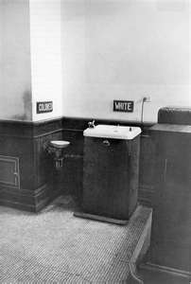
Plessy Vs. Ferguson

Slide 7
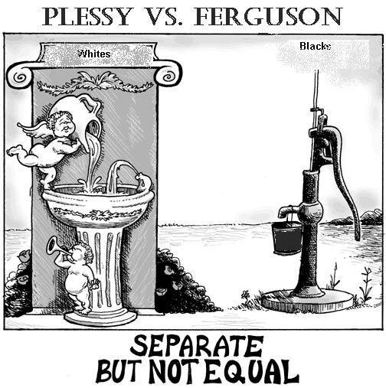
Under Plessy Vs. Ferguson.

Slide 8
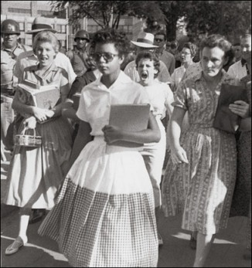
The Civil Rights Movement.

Slide 9
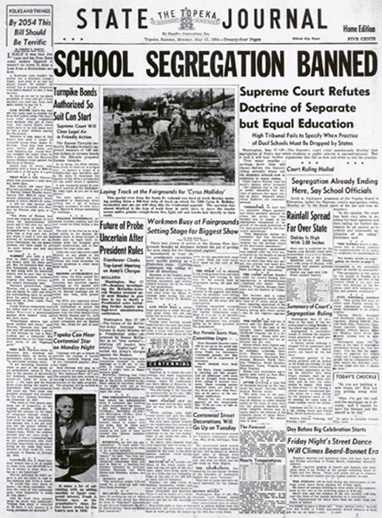
Brown Vs. Board of Education of Topeka Kansas.

Slide 10
Integration
After the Brown Vs. Board of Education of Topeka, Kansas ruling schools were forced to begin integration.
This was not an easy process often times leading to bitter disputes.
In Little Rock Arkansas The Little Rock 9 were escorted into the school by federal troops after being blocked from attending Central High

Slide 11
Civil Rights Victories
Brown Vs. Board of Education of Topeka, Kansas – Made segregation based on race illegal.
Civil rights Act of 1964 – Prohibited discrimination in public places.
The 1965 Voting Rights Act made it easier for blacks to vote.
The 1968 Fair Housing Act stopped discrimination in the sale or rental of property.

Slide 12
Navajo Code Talkers
400 Navajo Volunteers joined the Marines in forming the Navajo Code talkers in World War II.
Using the Navajo Language they created a secret code to important messages during the important battles in against japan.
450 key military words translated into code by the Code Talkers.
Navajo Code Talkers Day is August 14th every year.

Slide 13
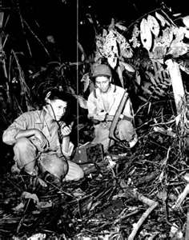
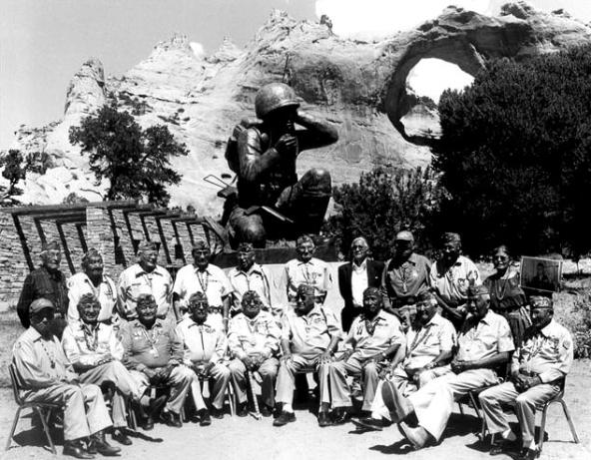
Navajo Code Talkers

