Slide 1
Historic Maps Historical Maps
Why are they impostant?

Slide 2
Historical Maps
A historic map is a map drawn or printed in the past that fosters study and comprehension of the geography or geographical ideas of the time and place in which it was produced.

Slide 3
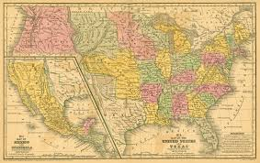
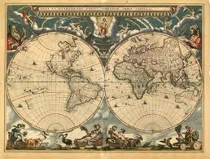
Historic Map Examples

Slide 4
Historical Maps
A historical map is a modern map made to illustrate some past geographical situation or set of historical events.

Slide 5
Historical Map Examples
https://journeys.maps.com/what-do-historical-maps-show/
http://news.bbc.co.uk/2/hi/uk_news/magazine/8654102.stm
http://www.mexconnect.com/photos/5985-h2-preclassic-period-2000-b-c-250-a-d-setting-the-stage

